Slide 1
BeautifulSoup
VADLA PRAVEEN KUMAR

Slide 2
What is Beautiful Soup?
Beautiful Soup is a Python library used for parsing HTML and XML documents. It provides a simple and intuitive way to navigate, search, and modify the parse tree. It is commonly used for web scraping and data extraction tasks.

Slide 3
Installation and Setup
Steps
Instructions
1
Open your terminal or command prompt.
2
Type 'pip install beautifulsoup4' and press Enter to install Beautiful Soup.
3
Wait for the installation to complete.
4
Once installed, import the library into your Python script using 'from bs4 import BeautifulSoup'.
5
You are now ready to start using Beautiful Soup for parsing and manipulating HTML!

Slide 4
Beautiful Soup
Features
Parses HTML, XML, and other markup languages.
Supports multiple programming languages, including Python, JavaScript, and Ruby.
Provides a powerful API for navigating and manipulating HTML documents.
Use Cases
Web scraping and data extraction from websites.
Automating web testing and validation.
Building web applications and APIs.

Slide 5
Advanced Features of Beautiful Soup
Handling Multiple HTML Tags
Beautiful Soup can handle multiple HTML tags by using the ‘find’ and 'find_all' method. This method returns a list of all the elements that match the specified selector.

Slide 6
Beautiful Soup: Handling Multiple HTML Tags
Using 'find' and 'find_all'
The 'find' method is used to search for a specific HTML tag within a document. For example, if you want to find all the <p> tags within a <div> tag, you can use the following code:
soup.find('div', {'class': 'my-class'})
The 'find_all' method is used to find all instances of a specific HTML tag within a document. For example, if you want to find all the <p> tags within a <div> tag, you can use the following code:
soup.find_all('p', {'class': 'my-class'})

Slide 7
from bs4 import BeautifulSoup
import requests
import pandas as pd
import matplotlib.pyplot as plt

Slide 8
url = "https://en.wikipedia.org/wiki/List_of_largest_companies_by_revenue"
page = requests.get(url)
soup = BeautifulSoup(page.text, 'html.parser')
# Find the correct table using the right class name
tables = soup.find('table', class_="wikitable sortable")
# Create an empty DataFrame with the appropriate column names
column_data = [header.get_text(strip=True) for header in tables.find_all('th')[1:8]]
df = pd.DataFrame(columns=column_data)

Slide 9
from bs4 import BeautifulSoup import requests import pandas as pd
url = 'https://en.wikipedia.org/wiki/List_of_largest_companies_by_revenue'
page = requests.get(url) soup = BeautifulSoup(page.text, 'html')
# print(soup)
soup.find('table')
table = soup.find_all_next('table', class_='wikitable sortable')
world_titles = table.find_all('th')[1:9]
#world_titles df = pd.DataFrame(columns=world_table_titles)
# df column_data = table.find_all('tr')
for row in column_data[2:]
row_data = row.find_all('td')[:8]
Individual_row_data = [data.text.strip() for data in row_data]
# print(individual_row_data)
length = len(df)
df.loc[length] = individual_row_data
df.to_csv('C:\Users\saich\OneDrive\Desktop\python\final.csv')

Slide 10
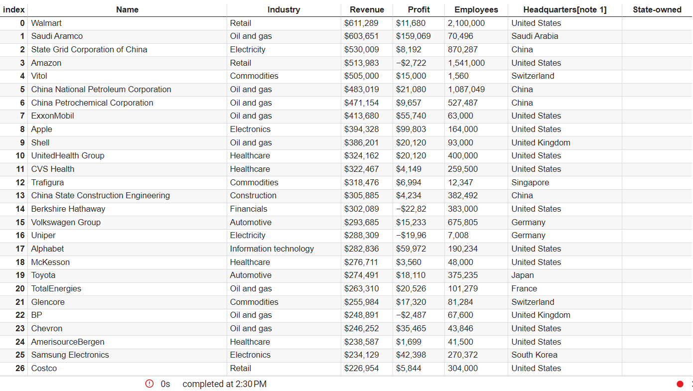

Slide 11
Final.csv

Slide 12
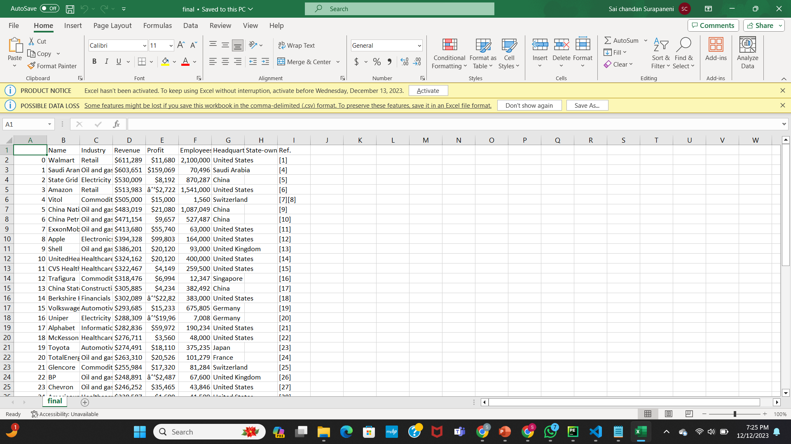
final.csv

Slide 13
To plot
names = df['Name']
revenues = df['Revenue']
plt.figure(figsize=(10, 6))
plt.bar(names, revenues)
plt.xlabel('Company Name')
plt.ylabel('Revenue (USD million)')
plt.title('Top Companies by Revenue')
plt.xticks(rotation=90)
plt.tight_layout(bottom=0.3)
# Show the plot
plt.show()

Slide 14
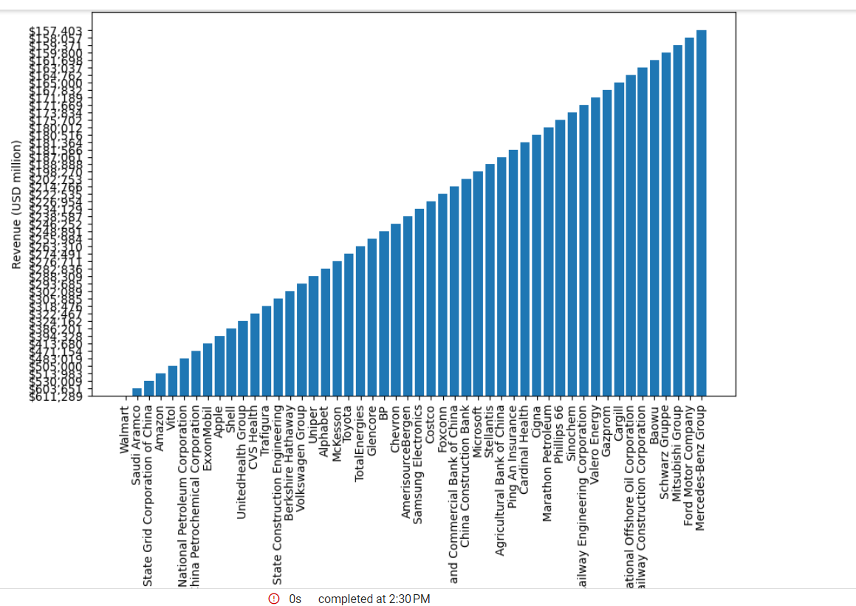

Slide 15
for image scraping
﻿
img_url = 'https://upload.wikimedia.org/wikipedia/commons/thumb/d/d4/Walmart_store_exterior_5266815680.jpg/1200px-Walmart_store_exterior_5266815680.jpg'
image_data = requests.get(img_url).content
with open(r'C:\Users\saich\OneDrive\Desktop\python\downloaded_image.jpg', 'wb') as f:
f.write(image_data)
print('Image downloaded successfully.')

Slide 16
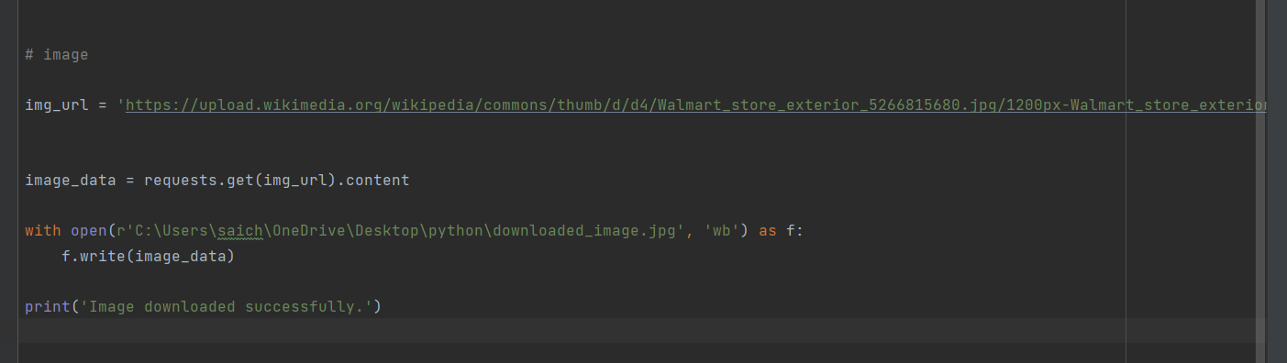

Slide 17
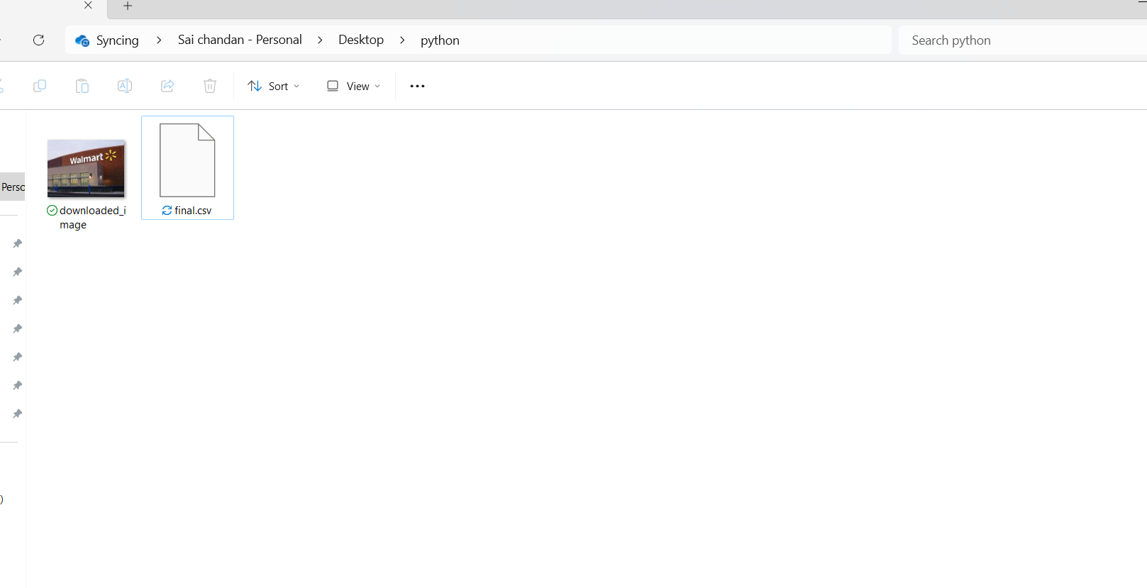

Slide 18
Thank you

